Slide 1

GENERAL TRAINING

Slide 2
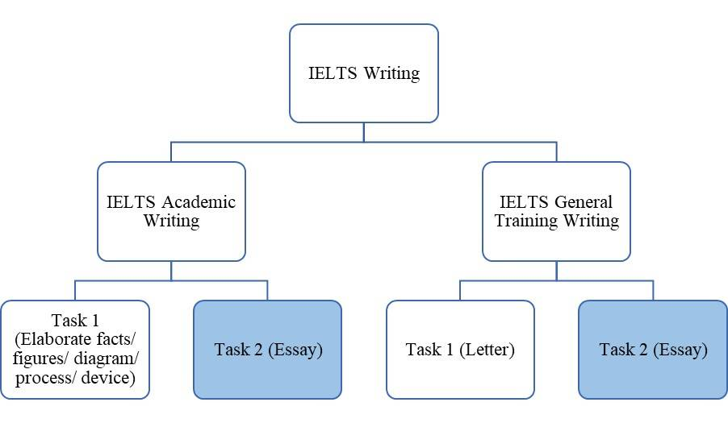

Slide 3
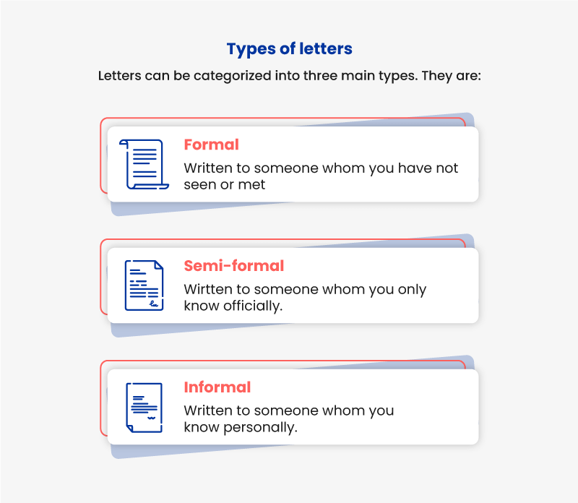

Slide 4
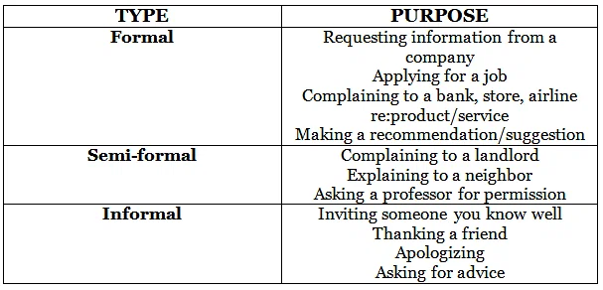

Slide 5
Formal Letters
You missed an international flight due to a problem at the airport.
Write a letter to the airline. In your letter:
Describe what happened that caused you to miss your flight
Explain how missing your flight impacted you
Clearly state what you would like the airline to do
Write at least 150 words. You do NOT need to write any addresses.

Slide 6
Formal Letters
Dear Sir or Madam,
I am writing in regards to an international flight that I missed due to reasons beyond my control.
For the past two weeks, I have been traveling for business and speaking at international conferences. Unfortunately, I arrived to the Tokyo airport over three hours delayed yesterday afternoon, due to the technical difficulties experienced by one of your company's aircrafts. Consequently, I missed my connecting flight from Tokyo to Madrid, and could not attend the conference. As a result of the delay, my company had to send another executive to speak at the conference in Madrid. This is not only a major inconvenience on our end, but it is a costly expenditure as well. Additionally, I have had to pay out of pocket for my lodgings in Madrid.
Since the delay was caused by your aircraft, I hope that you will compensate me for the cost of my lodgings in Madrid as well as my additional flight home to Toronto, Canada. I look forward to your response. Yours faithfully, Amanda Traynor

Slide 7
Informal Letters
You want to sell some of your furniture. You think a friend of yours might like to buy it from you. Write a letter to your friend. In your letter
• explain why you are selling • describe the furniture • suggest a date when your friend can come and see the furniture
Write at least 150 words.

Slide 8
Informal Letters
Dear Jan,
As you know, we'll be moving to a new house soon and there are a few things that I won't be able to take with me. The new house is a bit smaller so I have to sell some furniture and I was wondering if you might be interested?
In particular I want to sell my big dining table. Do you remember it - the one in the living room? It has wooden legs and a grey glass top and it’s big enough for six people. There are six matching chairs to go with it.
I know you've always liked this furniture so I could let you have it at a good price. I'd rather sell it to you than to a stranger!
Why don’t you come around and take another look at them on Saturday? We’ll be here all day, so maybe we could have some lunch together?
Give me a ring and let me know.
Love, Shanda.

Slide 9
Semi Formal Letters
You were absent from an important event held by the company you work for.
Write a letter to your manager. In your letter:
Apologize for your absence and explain the reasoning
Explain why you had to be at the other event
Explain what you will do to catch up
Write at least 150 words. You do NOT need to write any addresses.

Slide 10
Semi Formal Letters
Dear Mr. Brannagan,
I am writing in regard to my absence from the annual company business meeting held last week.
First off, I would like to formally apologize for not being able to attend the business meeting. I recognize the importance of the event, especially in terms of networking and growing as a team. However, my mother had an invasive spinal surgery last weekend, and I spent the last week taking care of her at home. While the surgery was not life-threatening, it was not a routine procedure, either. My mother required constant assistance and faces a long road to recovery. Since I am an only child, my mother relied on me during this difficult recovery period, and my presence was a necessary part of her well-being.
In order to catch up on what was covered during the event, I have scheduled a meeting with Mr. Harris from the Finance Department. After meeting with Mr. Harris, I am confident that I will be brought up to speed with the rest of the team and ready to start working. Thank you for understanding. Sincerely, John Traynor

